Slide 1

PATH FINDING VISUALIZER

Slide 2
Presented By:
Satyam Dighe
Sushant Mahadwad
Kunal Suryawanshi
Deepak Rai

Slide 3
ABSTRACT :
Visualization is an efficient way of learning any concept faster than conventional methods. Modern technology allows creating e-Learning tools that also helps in improving computer science education very much.
The goal of this project is to create a web based e-Learning tool, ‘Pathfinding Visualizer’, which can be used to visualize shortest path algorithms. The conceptual application of the project is illustrated by implementation of algorithms like Dijkstra’s , A* and DFS. This project aims to complete all these tasks with some knowledge of HTML, CSS, JavaScript and React Framework.
The end product is a web application so that any user can easily see and learn the working of the algorithms. User-friendliness of the project provides user with easy instructions on how to operate it. The initial results of using the application show promises of the benefits of this e-Learning tool towards students getting a good understanding of shortest paths algorithms.

Slide 4
INTRODUCTION:
At present, e-learning is being promoted at a very high rate among learners in different areas. Modern technologies allows the development of visualization tools for topics like different algorithms of graph theory and their explanation. The implementation of e-learning tools like this is one of the most important requirement for applying e-learning system successfully. Learning through visualization has been found helpful in enhancing learning capabilities. It adds more autonomy to the learning process for an individual person. By providing a visual representation of how the algorithms looks for destination node, the application aim at making it more understandable. Good algorithm visualization tools brings the algorithms to life by displaying the traversal of nodes by animating the transitions from one node to another.
One of the widely used application of graph theory is determination of shortest path in many practical application like maps , road networks and robot navigation. We use Dijkstra’s algorithm to demonstrate the working of the tool because it also works for a weighted graph. Hence, it takes longer time to run compared to BFS. This algorithm guarantees the shortest path possible. Also, using online learning methods instead of face to face lectures has the power to improve learning with regards to better performance of students, satisfaction of student, and a higher flexibility in learning for the students.

Slide 5
LITERATURE REVIEW :
e-Learning is one of the best outcome brought forward by transformation of the internet. It has made users capable of gathering education and knowledge along with it fruitfully from different resources out there and effectively utilize it to learn and rapidly obtain up to date information. Different problems require different solution and similarly different types of e-learning include blending and informal learning, network-based learning. Both asynchronous and synchronous methodology of e-Learning are equally important.
e-Learning is a modern solution to train and help workforce in acquiring required knowledge and skills which are needed to turn change into an advantage and create more opportunities. As a result, many corporations have realized that e-Learning can be used to help keep their employees stay updated with new advances and add new skills to keep providing better solutions and that synchronous tools should be used hand in hand with asynchronous environments to allow for 24*7 available learning model. e-Learning has been proven to be very effective in current situation of covid. e-Learning has made it possible to provide education anytime, anywhere. e-Learning can successfully replace Campus-based Classrooms and help in improving Student Performance.

Slide 6
PROBLEM ANALYSIS :
In recent years, we have seen huge growth in computer science education.
There are many difficult topics in computer science , that are very complex to learn and in particular algorithms like shortest path algorithms, these are often hard and complex to understand.
Modern technologies has proven to be a boon for learning process. Visual aids have been recognised as means to amplify learning capabilities of an individual.
⚫ Easy to use
⚫ Ensure visualization better by adding animation
⚫ Ability to add obstacles in the path

Slide 7
MODULES :
The project consists of different modules that perform various task.
These modules are algorithm module, node module and path visualizer module.
These modules can be implemented within the home network and over internet as well.
Algorithm Module:
It contains the needed function for traversing the nodes on the grid and solving of the graph shortest path problem.
This module contains Dijkstra’a algorithm, A* and DFS algorithms as well. We can move in only four ways: Up, Down, Right, Left. This means that all the nodes are equally weighted.

Slide 8
Node Module:
Path Visualizer Module:
When the algorithm starts the search for the destination node and begins the traversing as per the function, the node module covers the creation of animation that shows the direction of traversal and the nodes being traversed.
It also takes care of the animation during path plotting between source and destination node on the grid.
The Path Visualizer Component handles the mouse operations, implements the algorithms of algorithm module on the grid and handles all operation performed on the grid.

Slide 9
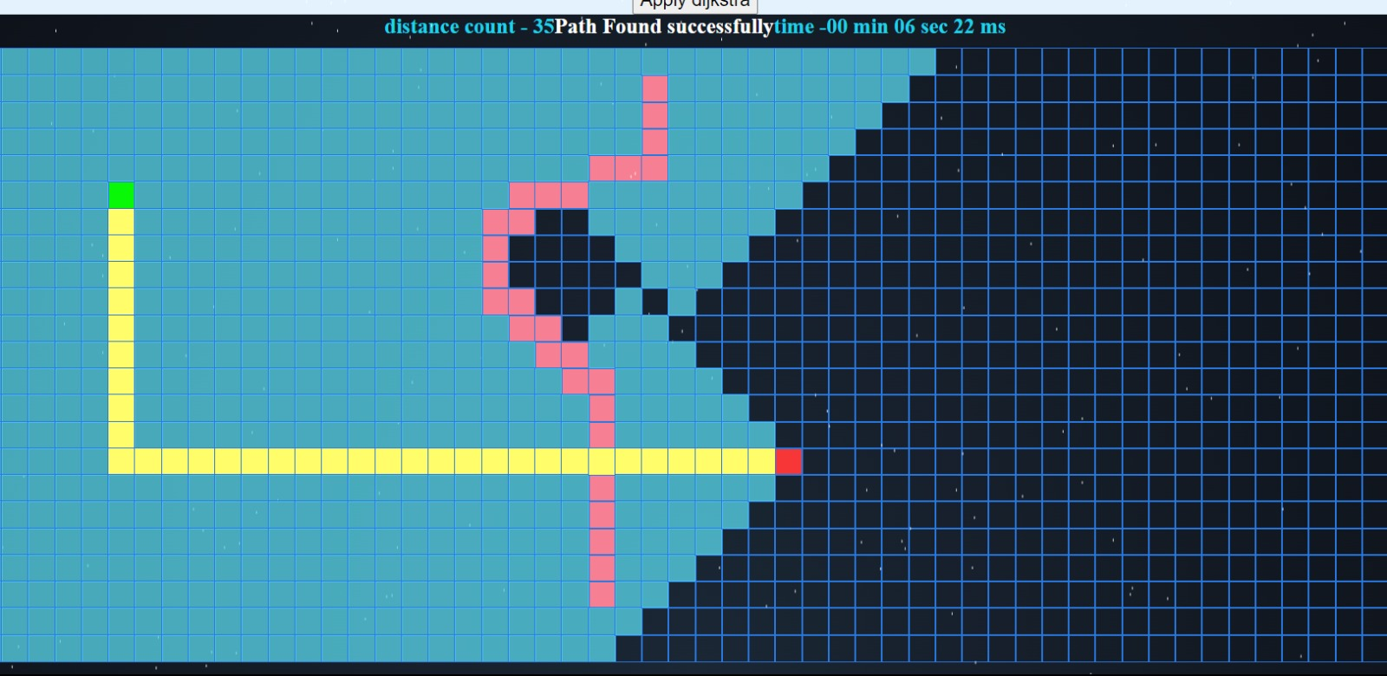
OUTPUT: Dijikstra :

Slide 10
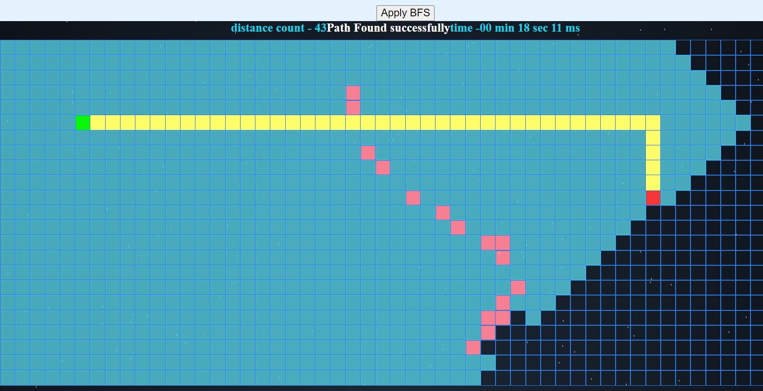
BFS:

Slide 11
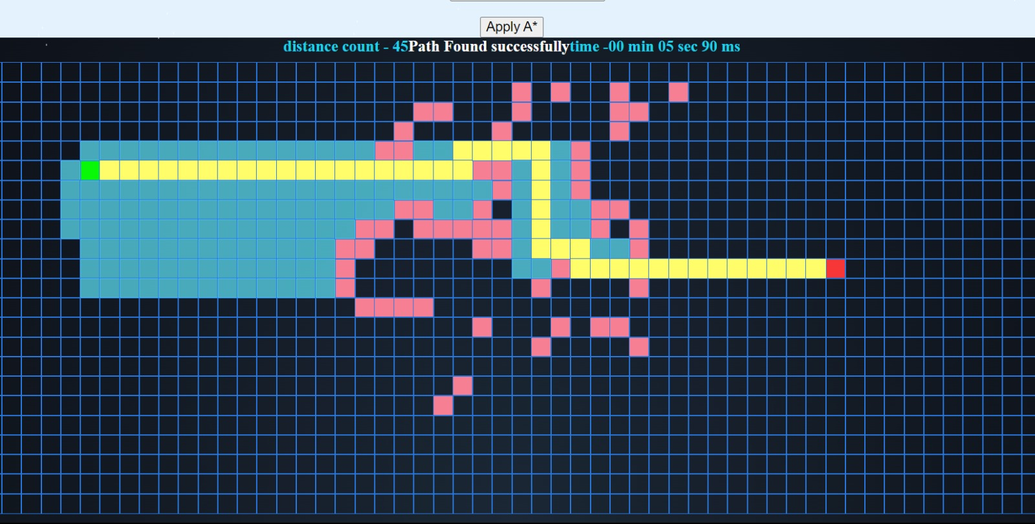
A*:

Slide 12
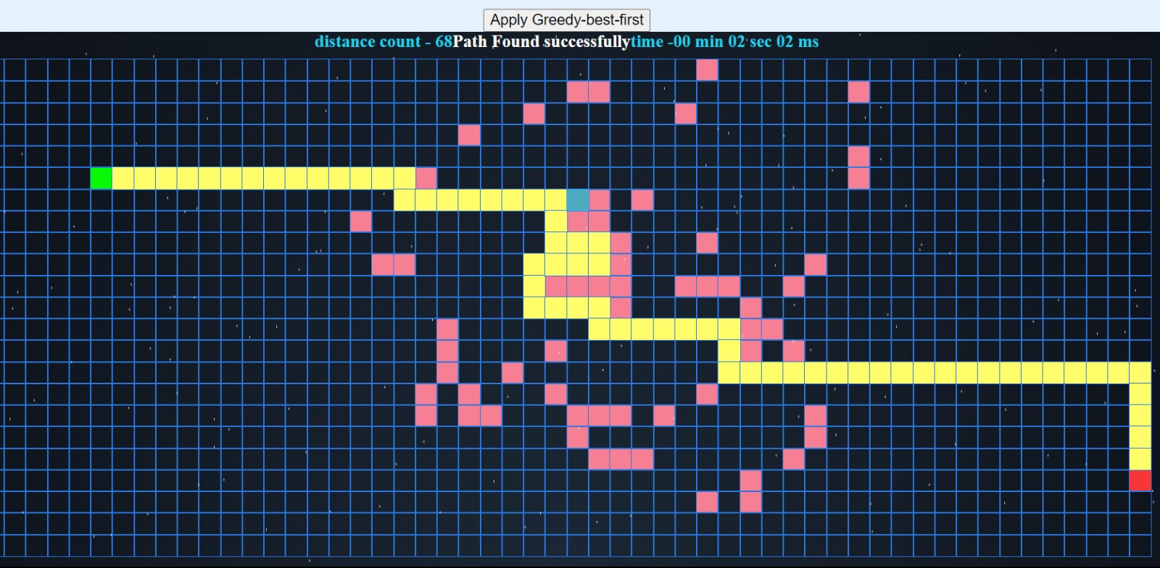
Greedy best first:

Slide 13
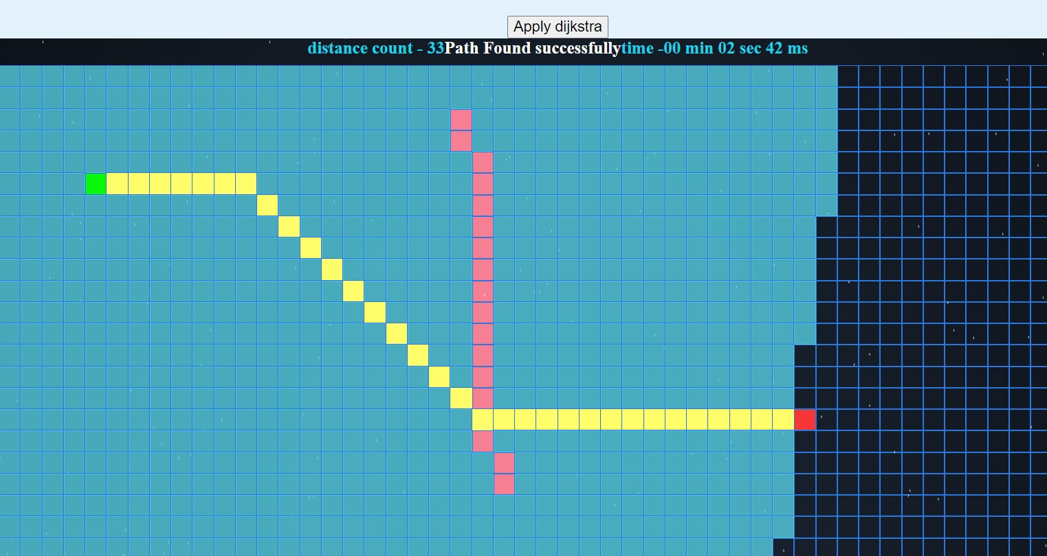
Diagonal Dijikstra:

Slide 14
CONCLUSION :
e-Learning is a modern solution of providing education and knowledge. Different tools are being made for the purpose of implementing this method of learning and also to make people realize its importance and adopt it. Both synchronous and asynchronous methods of learning are equally important. e-Learning tools accommodates everyone’s need, from a beginner to the expert and their consistency also proves their effectiveness again traditional ways. The web application helped in visualizing the working of pathfinding algorithms and made it look quite quite easily understandable.
Further development of this tool can include visualization of more e complex algorithms, implementation over real world map.

Slide 15
ACKNOWLEDGEMENT :
We have given considerable time and taken efforts in this work. However, many individuals helped and supported us in completing this work. We would like to extend our most sincere thanks to all those people.
We thank Mr. P. Raja Kumar for his role as our guide and always be there by providing constant supervision and for providing his necessary inputs and information regarding the project.
We thank our parents & friends of Galgotias University for their encouragement and co-operation which led us to successfully complete this work.
We would like to give our special thanks to industry personnel for giving us their attention and time.

Slide 16
REFERENCES :
[1] Alexander, S. (2001), ``e-Learning developments and experiences'', Education and Training, Vol. 43 Nos 4/5, pp. 240-8
[2] Daniela Borissova, Ivan Mustakerov “E-learning Tool for Visualization of Shortest Paths Algorithms”
[3] Magzhan Kairanbay, Hajar Mat Jani(2013), “A review and evaluations of Shortest Path Algorithms ”, International Journal of Scientific & Technology Research 2(6):99-104

Slide 17
Thank You

